Slide 1

Machine Learning in Science part ii
Harry Durnberger
Kshitij Tiwari
Henry Willett

Slide 2
Objective
Develop a deep learning model for a self-driving car.
The project was divided into two phases to test the performance of the model:
Kaggle competition
Live testing
In the first half, dataset provided in the Kaggle competition was used for training.
The performance of the model was judged on the basis of it’s performance on the test set.
Part of the test was hidden to make ensure that the models were being judged on their performance on unseen data.

Slide 3
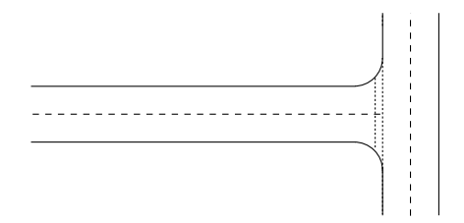
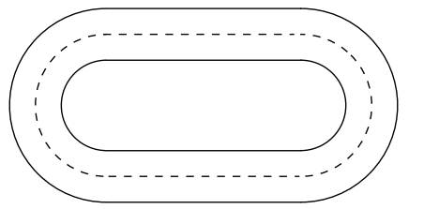
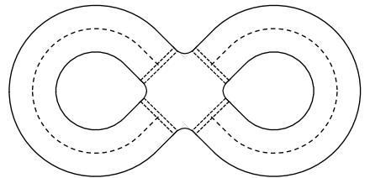
Tracks used for live testing
The following tracks used for the live testing phase:
T-junction
Oval
Figure-of-eight
(1) T-Junction Track
(2) Oval Track
(3) Figure-of-eight Track

Slide 4
Tracks used for live testing
The T-junction track assessed the model’s ability to;
Steer the car in a straight line
Recognise and turn the car in the direction the arrows (placed at the junction) are pointing towards
The oval track tested the ability of the car to travel in a straight line as well as turn when needed.
The figure-of-eight was used to test if the model was capable of;
Turning the car while simultaneously staying in the correct lane
Crossing the intersection while staying on the correct driving lane
Reacting to traffic lights placed on the intersection
Additionally, the ability to react to various obstacles (on and off the tracks) was also tested.

Slide 5
Key challenges
Kaggle phase:
Choosing the model architecture for accurate predictions and optimal performance
Choosing between having two separate models for speed and angle or creating a combined model
Improving the accuracy of the model while also keeping it generalised
Optimising the model’s performance for training time
Live-testing phase
Collecting additional data for certain tracks
Balancing the dataset to ensure proper training and performance on all the tracks
Reducing the inference time to make sure the model can react to changes in the tracks in real-time

Slide 6
Dataset
The training data provided for training the model during Kaggle competition contained approximately 13,800 images.
It consisted of images from the perspective of a car while it’s driven around the various tracks.
Images were collected from a camera mounted on the car.
Issues with the given dataset;
Imbalanced dataset, particularly for the speed label (Approximately four images with label 1 for every one image with label 0)
The size of the dataset was inadequate for a deep learning

Slide 7
preprocessing
The following methods were used to prepare the data for the training process;
Removing corrupted data
Checking for incorrect labels
Resizing the images to improve the training process
Data augmentation
Five corrupted files were found.
1 image was found having an incorrect label.
Initially, due to the use of ImageNet, the images were resized to 224X224. Later on the dimensions were reduced to 32X32 for the final model.

Slide 8
Preprocessing
Additionally, data augmentation was used to improve the model and balance the dataset.
It is the process of creating a set of artificially modified copies of the existing data which are then added to the training set.
The list of features with for augmentation:
Random flip ands rotation
Brightness
Contrast
Saturation

Slide 9
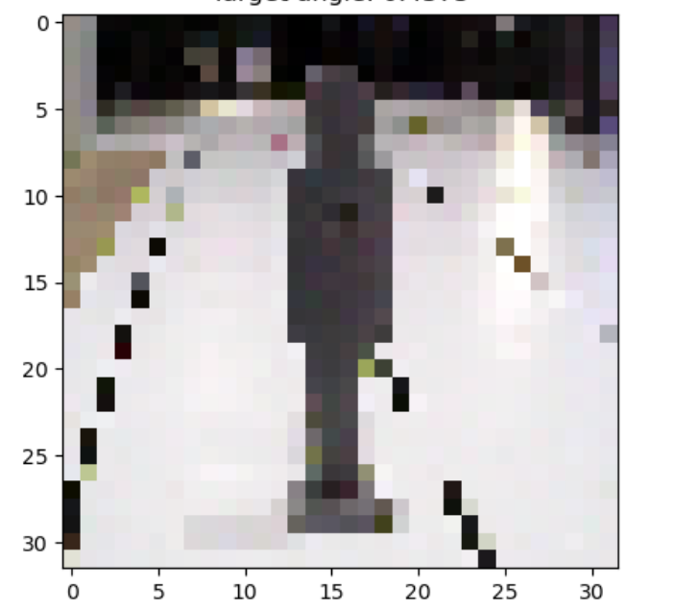
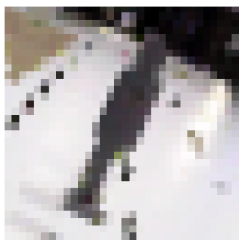
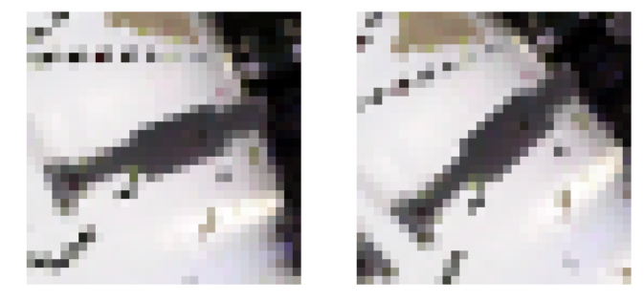
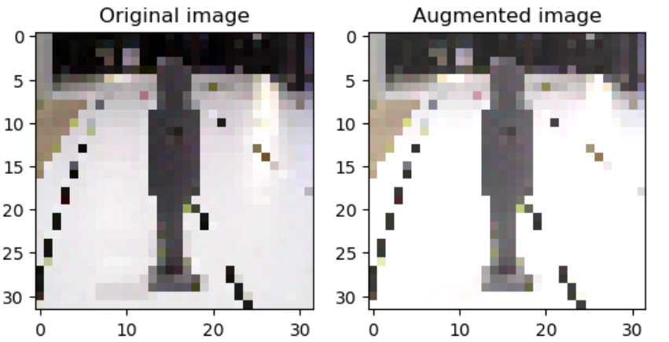
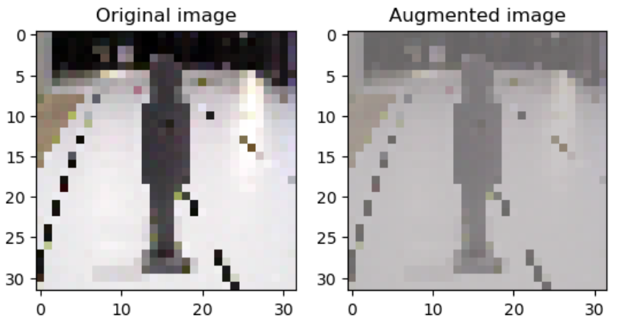
Examples of data augmentation
Random Rotation
Random Brightness
Random Contrast

Slide 10
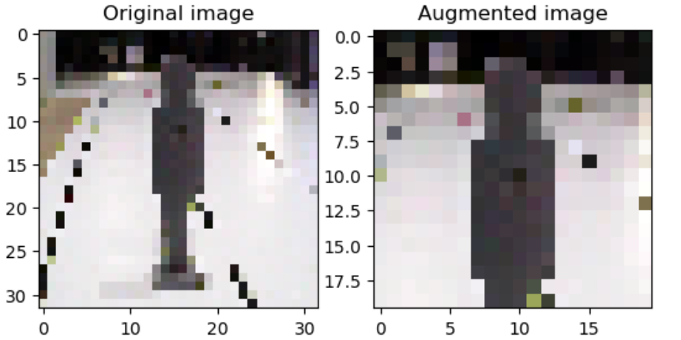
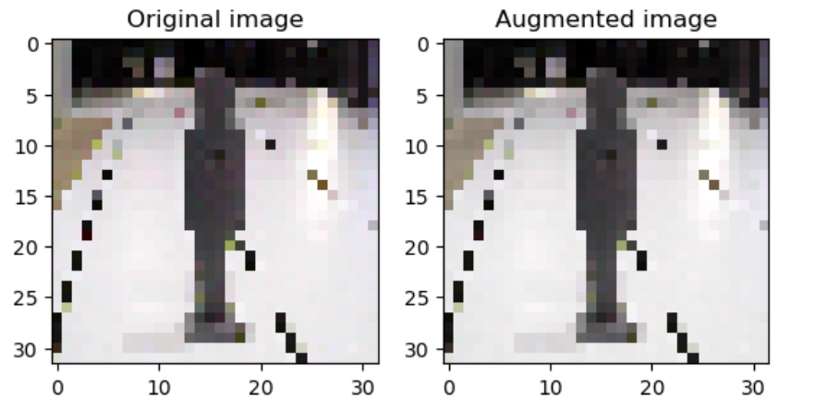
Examples of data augmentation
Random Crop
Random Saturation

Slide 11
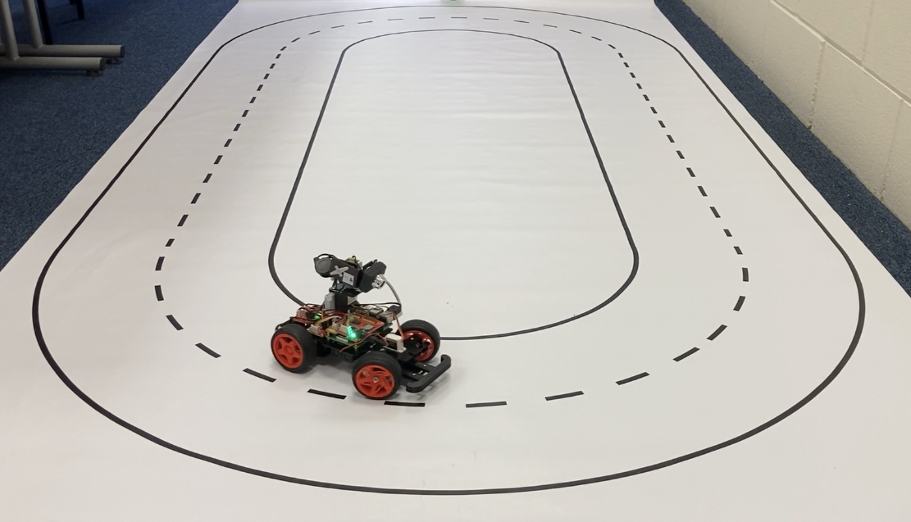
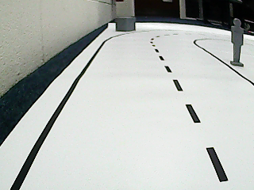
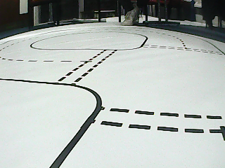
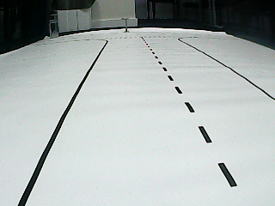
Data collection
More data, more general model.
Help model learn more difficult tracks/tasks.
Acquired labelled samples by remote controlling car.
Providing “supervision”.

Slide 12
Final Dataset
27,347 images.
~ 3GB.
320 x 240 RGB.
Very underrepresented ‘speed=0’ class – 7:1 ratio

Slide 13
Building the model
Model built and trained in python.
TensorFlow 2 to leverage GPU for training.
GPU allows faster training and larger batches.

Slide 14
Initial Model
Speed output (1,)
MobileNetV2
Inputs (224,224, 3)
Angle output (1,)
Drawbacks:
Large model, costly to train
GPU memory inadequate for training earlier layers
No indication of significant performance gain
Inference time would be too slow
Attempted transfer learning
MobileNetV2 – trained on Imagenet
Train output weights
Sandler, M., Howard, A., Zhu, M., Zhmoginov, A., and Chen, L.-C., “MobileNetV2: Inverted Residuals and Linear Bottlenecks”, <i>arXiv e-prints</i>, 2018. doi:10.48550/arXiv.1801.04381.

Slide 15
Final model architecture
Layer 1
30x30x32
Layer 2
15x15x32
Layer 3
13x13x64
Layer 6
1x1x64
Layer 7
1x1x10
Layer 4
6x6x64
Layer 5
4x4x128
Multi-output CNN
Convolution filter – Kernel size 3x3, No padding
Max-pooling – Kernel size 2x2, No padding
ReLu activation functions
450,090 parameters
Lightweight
Input image
32x32
Speed output (1,)
Layer 1
30x30x32
Layer 2
15x15x32
Layer 3
13x13x64
Layer 6
1x1x64
Layer 7
1x1x10
Layer 4
6x6x64
Layer 5
4x4x128
Angle output (1,)
Convolution
Max Pooling
Activation
Dense layer

Slide 16
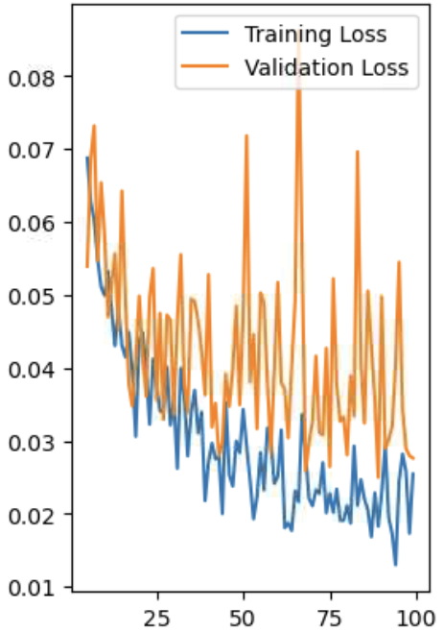
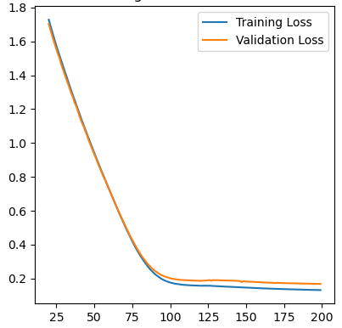
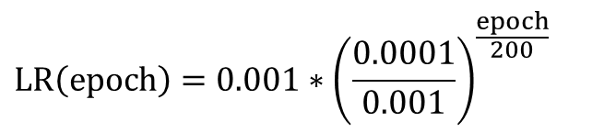
Training: Loss
Binary cross entropy for speed
Loss functions
Optimiser: Adam
Batch size: 40
Epochs: 200
MSE for angle
Initially unstable:
Stable:
To stabilise loss:
Lowered learning rate – but training became too slow.
Learning rate schedule.
Exponentially decaying learning rate:
$$LR\left(epoch\right)=0.001∗{\left(\frac{0.0001}{0.001}\right)}^{\frac{epoch}{200}}$$

Slide 17
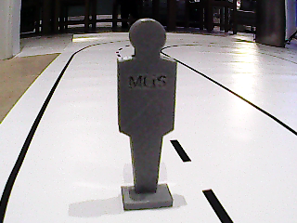
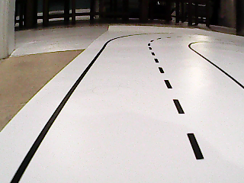
imbalanced data: Class weighting
Speed=0 (12.5%), Speed=1 (87.5%).
Initially model always predicts Speed=1.
Class weighting:
Misclassifying a minority class sample will result in a higher loss compared to misclassifying a majority class sample.
Makes the model more sensitive to the minority class.
Used evaluation metrics to tune weights.
Speed=0
Speed=1
Weight=7
Weight=1

Slide 18
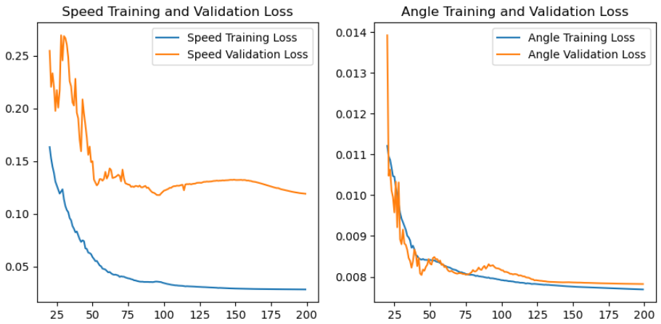
Overfitting
Separate speed and angle loss
Speed model is significantly overfitting

Slide 19
Regularization
Apply regularization to each layer.
Combination of dropout (rate=0.5) and L2 regularization.
Heavier L2 regularization applied to dense layers in speed branch.
Hyperparameter tuning.
Effects:
Forces more general model.
Brings validation loss closer to training loss.
Layer 1
30x30x32
Layer 2
15x15x32
Layer 3
13x13x64
Layer 6
1x1x64
Layer 7
1x1x10
Layer 4
6x6x64
Layer 5
4x4x128
Speed output (1,)
L2 = 0.01
L2 = 0.01
L2 = 0.7
L2 = 0.7
L2 = 0.01
Convolution
Max Pooling
Activation
Dense layer

Slide 20
Evaluation
Obtaining accurate predictions on unseen data.
Handling an imbalanced dataset.
Producing a robust model.

Slide 21
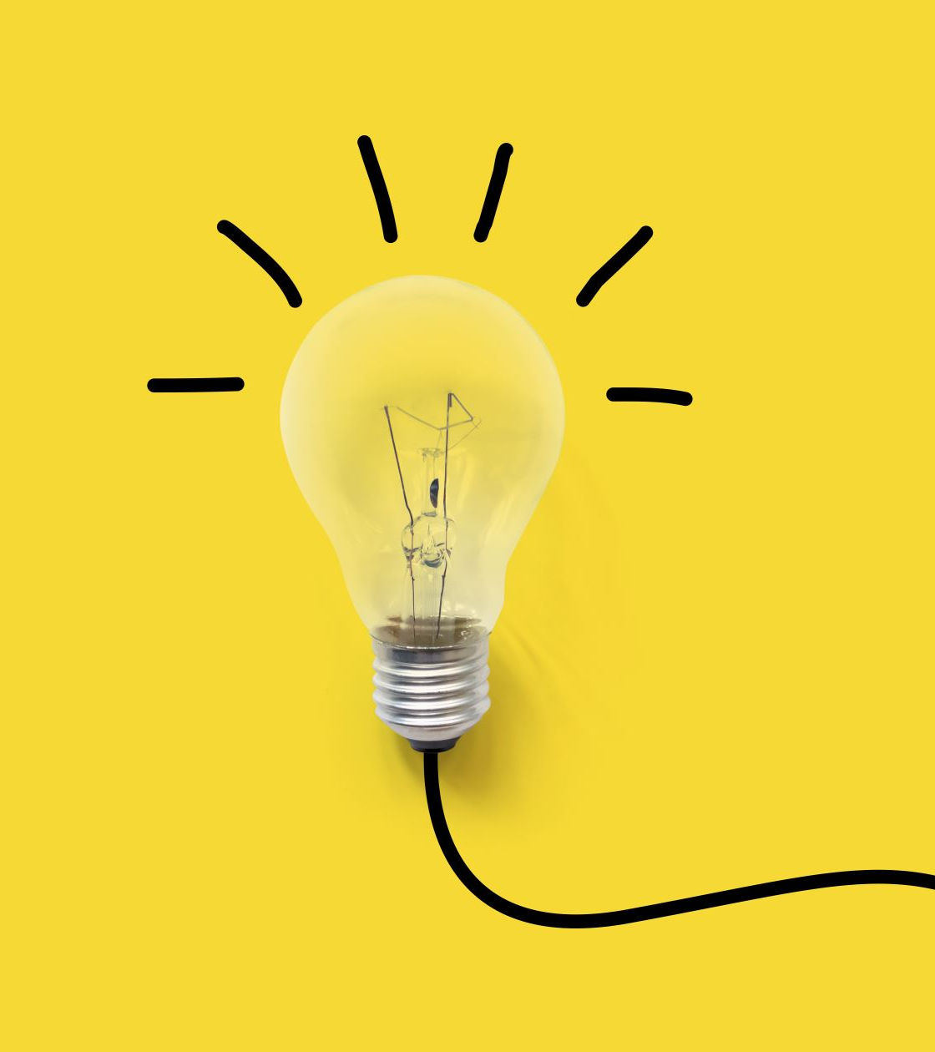
Metrics to evaluate model performance
More images of car moving (positive) than car stopped (negative).
F1 score: (Precision*Recall)/(Precision + Recall) .
Negative F1 score: (NPV*Specificity)/(NPV + Specificity).
Mean squared error combined.

Slide 22
Results and discussion
Evaluation Set: Speed Classification
Negative Prediction Value | 0.994
Specificity | 0.9736
Negative F1 Score | 0.9837
Evaluation set: Mean-Squared-Error
Overall | 0.0264
Speed | 0.0161
Angle | 0.0072

Slide 23
Live TESTING
In the first trials the model was only able to handle the oval track and stopping.
Upon collecting more data our model could almost cross an intersection but failed to handle the T-junction.
Final model had several issues could handle high speeds.

Slide 24
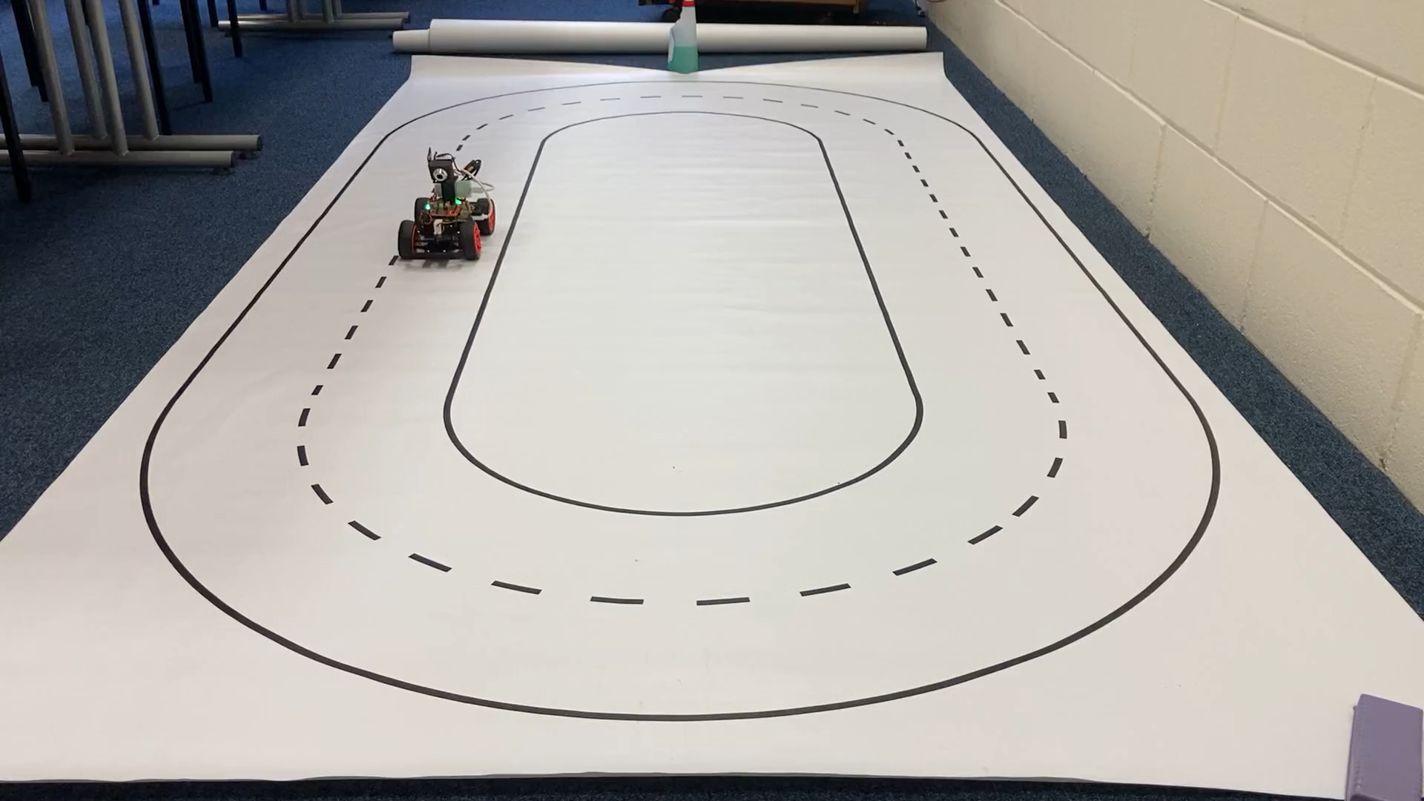

Slide 25
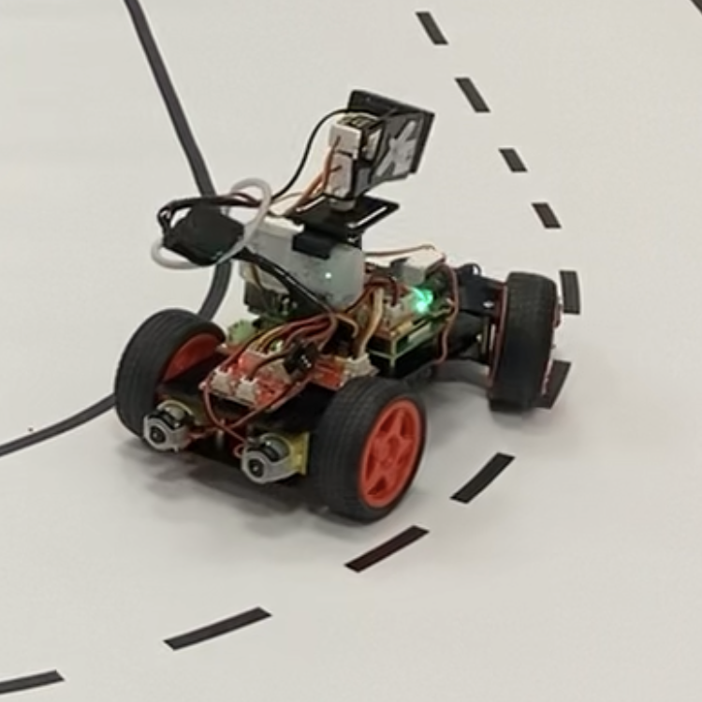
Inference optimisation
TPU
Fast inference is required for predictions to keep up with car.
Simple model with few layers – quicker to process.
Convert model to TensorFlow Lite to leverage TPU.

Slide 26
Final model evaluation metrics
Epochs
Epochs

Slide 27
Conclusion and improvements
Data collection
Complexity of model with higher computational power
Optimization of regularization

Slide 28
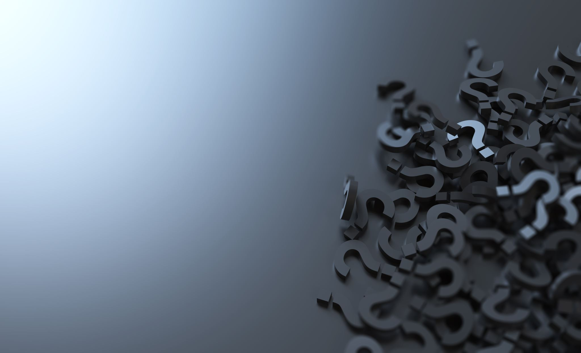
Questions?

